Slide 1
Avocado Price Predictor
Predicting the weekly price of an avocado with machine learning
Machine Learning Capstone, Chapter 14, Project 3
Marzia Binte Iqbal
Notes:
Good morning. This is Project 3 of my machine learning capstone: a model that estimates the average price of an avocado for a given week, region and type. I will cover the problem, the data, my solution, the results and a short demo.

Slide 2
1. The Problem
Avocado prices change a lot: from $0.44 to $3.25 per avocado in this data
Goal: estimate the average price for a given week, region and type
Type means conventional or organic
Success: do better than the simple guess “always the average price”
Notes:
Avocado prices move a lot. In the data I used, the average price in a week ranges from 44 cents to 3 dollars 25. The goal is to estimate the price for a given week, region and type, conventional or organic. This is a regression problem, because the price is a number. To count as useful, the model must do better than the simple guess of always predicting the average price.

Slide 3
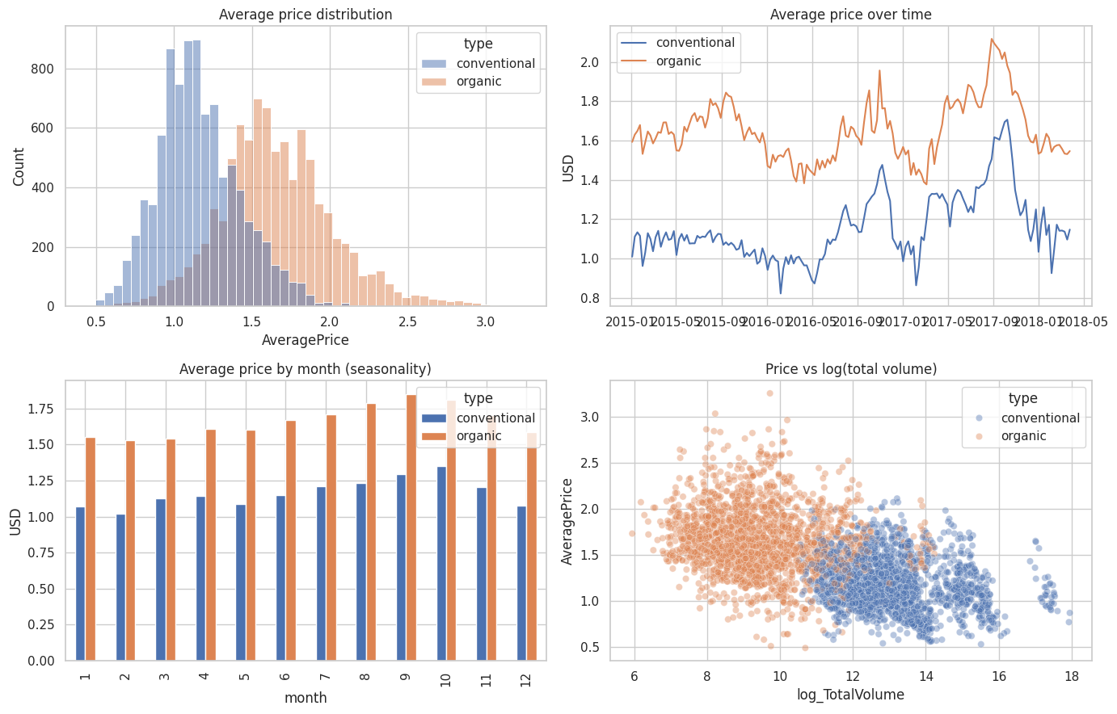
2. The Data
18,249 weekly records
54 regions, 2 types
January 2015 to March 2018
No missing values
Organic costs more: about $1.6 to $1.8, against about $1.1
More volume sold goes with a lower price
Notes:
The data is weekly retail sales from the Hass Avocado Board, taken from Kaggle. There are 18,249 records for 54 regions, from January 2015 to March 2018, and no missing values. The charts show three things. Organic avocados cost more, about 1 dollar 60 to 1 dollar 80 against about 1 dollar 10. Prices rose in 2017. And weeks with more volume sold tend to have lower prices, although part of that is simply because organic sells in smaller volumes.

Slide 4
3. The Solution
Train on the oldest 80% of weeks: January 2015 to July 2017
Test on the newest 20%: August 2017 to March 2018
Three approaches: the average-price guess, Linear Regression, Random Forest
Random Forest tuned with RandomizedSearchCV (12 trials)
Measured with RMSE, MAE and R²
Testing on later weeks avoids using the future to predict the past.
Notes:
I split the data by time. The model learns from the oldest 80 percent of the weeks and is tested on the newest 20 percent, so it never sees the future while learning. I compared three approaches: the simple average-price guess, a Linear Regression, and a Random Forest, which is many decision trees voting together. The Random Forest was tuned with a random search of 12 settings, checked with time-ordered cross-validation. I measure the error in dollars with RMSE and MAE, and R squared tells how much of the price variation the model explains.

Slide 5
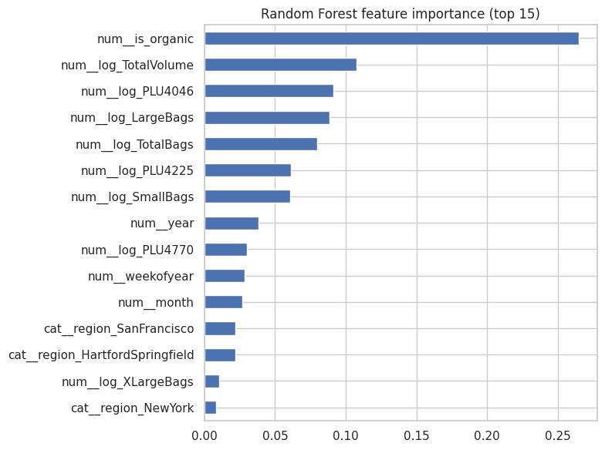
4. Business Impact
Model | RMSE | MAE | R²
Average-price guess | 0.423 | 0.322 | -0.152
Linear Regression | 0.290 | 0.217 | 0.460
Random Forest (default) | 0.279 | 0.209 | 0.498
Random Forest (tuned) | 0.288 | 0.213 | 0.467
Typical error: about $0.21 per avocado, 14% of the average price
Tuned Random Forest and Linear Regression perform about the same
The 2017 autumn price spike is underestimated
Money saved is not estimated: that needs real business data
Most important: organic or conventional, then sales volume
Notes:
Here are the results on the test weeks, the newest 20 percent of the data. Guessing the average price gives an error of 42 cents. Linear Regression and the Random Forest bring it down to about 28 to 29 cents. On average the tuned model is about 21 cents away from the true price, which is around 14 percent of the average price. The tuned Random Forest and the simple Linear Regression perform about the same, so the extra complexity did not buy much here. The model also underestimates the high prices of autumn 2017. I have not put a dollar figure on savings, because that needs real business data. On the right are the features the Random Forest relied on most: the type, then sales volume.

Slide 6
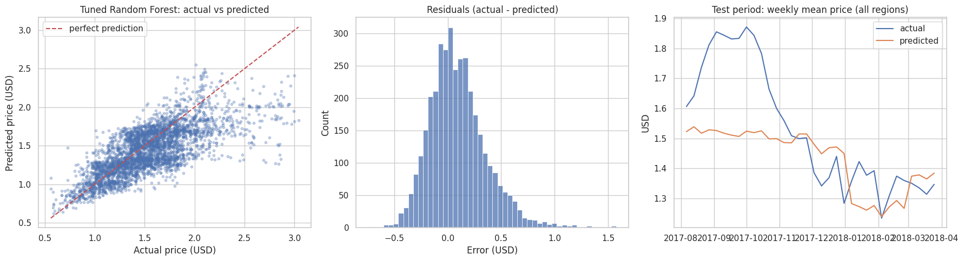
5. Demo and Next Steps
Demo
Next steps
Run all cells in the notebook
Section 9 predicts one price
New York, conventional, 25 March 2018: predicted $1.60, actual $1.34
Add weather, supply and holiday data
Test on several time periods
Try XGBoost and serve with FastAPI
Notes:
This is the optional live demo. In the notebook, section 9 predicts the price for one week. For New York, conventional avocados, the week of 25 March 2018, the model predicted 1 dollar 60 and the real price was 1 dollar 34. That is one example, not proof of average quality. The chart shows the test weeks: on the right, the real weekly price in blue and the predicted price in orange. The model misses the high prices of August to October 2017. Next steps: add weather, supply and holiday data, test on several time periods, try XGBoost, and serve the model through a FastAPI endpoint. Thank you. Questions?

